Slide 1
ABDOMINAL INJURIES
Moderator – DR. AHRIS , Asst. Professor Dept. of General Surgery
MOHAMMED HUSSAIN 15MO84

Slide 2
INTRODUCTION
Abdominal trauma is a major surgical emergency associated with head injuries, chest, pelvic and bone injuries.
Often patient is unconscious causing difficulty in diagnosing the condition.
The most common organ injured in the abdomen in spleen followed by liver

Slide 3
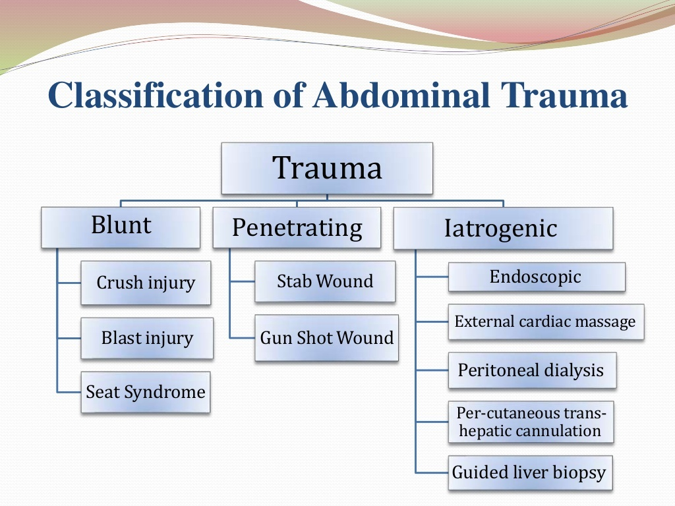

Slide 4
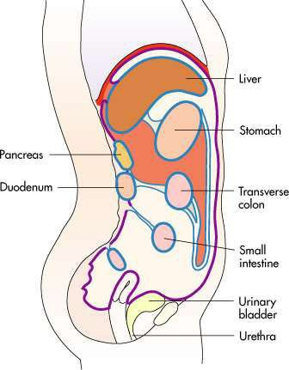
ORGANS INVOLVED
Liver
Spleen
Stomach
Small bowel
Large bowel
Pancreas
Kidney/bladder
Mesentery
Vasculature

Slide 5
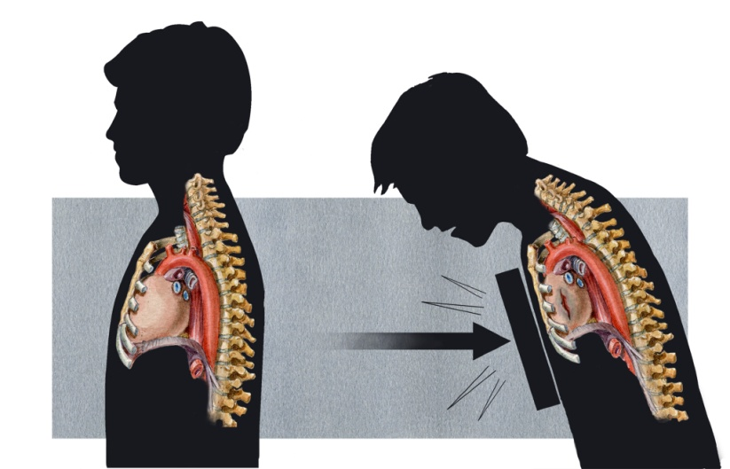
BLUNT TRAUMA
It produces least visible signs of injury. Common in accidents.
Often misdiagnosed or lately diagnosed.
Types
Deceleration
Contents damaged by change in velocity
Compression
Organs trapped between other structure
Shear
Part of an organ is able to move while another part is fixed

Slide 6
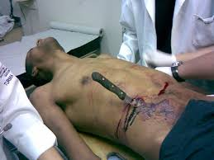
PENETRATING TRAUMA
•Results in-
Uncontrolled hemorrhage
Organ damage
Spillage of hollow organ contents
Irritation & Inflammation of abdominal lining
•Liver most commonly affected organ
•Common causes -Shotgun Trauma, stab wound, cuts & tears

Slide 7
LIVER TRAUMA
Second most common organ to get injured
Blunt trauma produces contusion, laceration and avulsion injuries often in association with splenic, mesenteric or renal injury.
Penetrating injuries such as stab and gunshot wounds are often associated with chest and pericardial involvement.
Blunt injuries are more common.

Slide 8
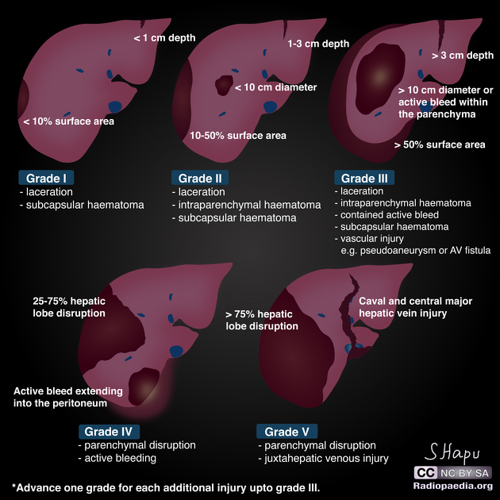

Slide 9
SPLEEN TRAUMA
Splenic rupture should be considered in any case of blunt abdominal trauma , particularly when the injury is in the left upper quadrant of abdomen.
Iatrogenic injury to the spleen remains a frequent complication of any surgical procedure particularly those on the left upper quadrant when adhesions are present.

Slide 10
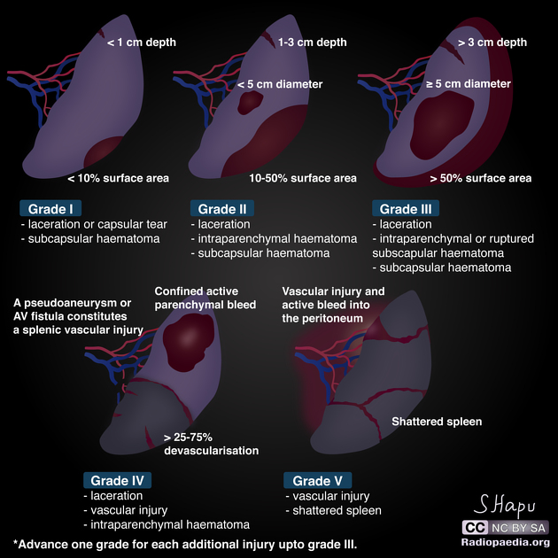

Slide 11
PANCREAS TRAUMA
As the pancreas is situated retroperitoneal, it is not frequently damaged by blunt trauma.
Occasionally, a forceful blow to the epigastrium may result in injury to the pancreas.
The injury may involve the parenchyma alone or along with duct disruption.
Cullen's sign - superficial edema and bruising in the subcutaneous fatty tissue around the umbilicus suggestive of acute pancreatitis.
Grey Turner's sign refers to bruising of the flanks, the part of the body between the last rib and the top of the hip.

Slide 12
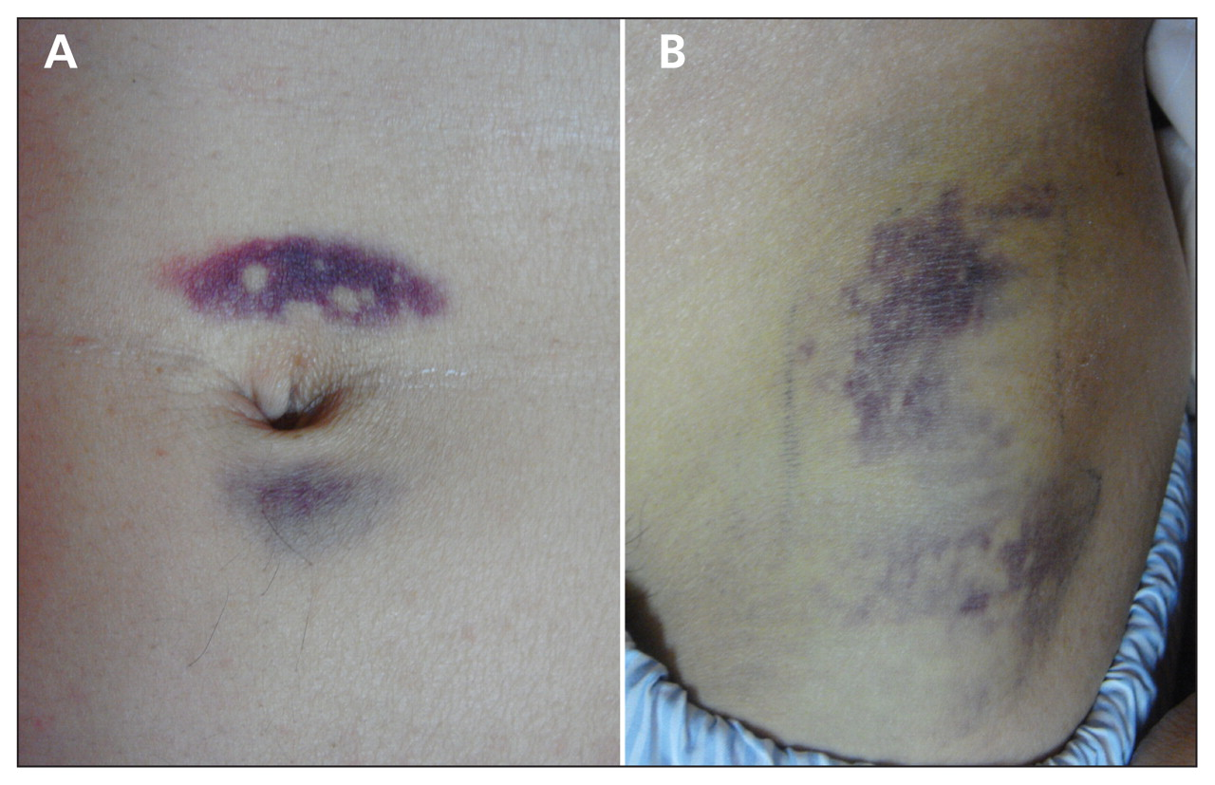
A. Cullen’s sign B. Grey turner’ sign

Slide 13
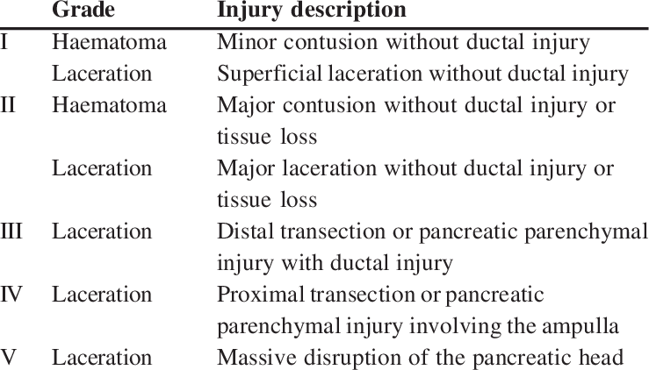

Slide 14
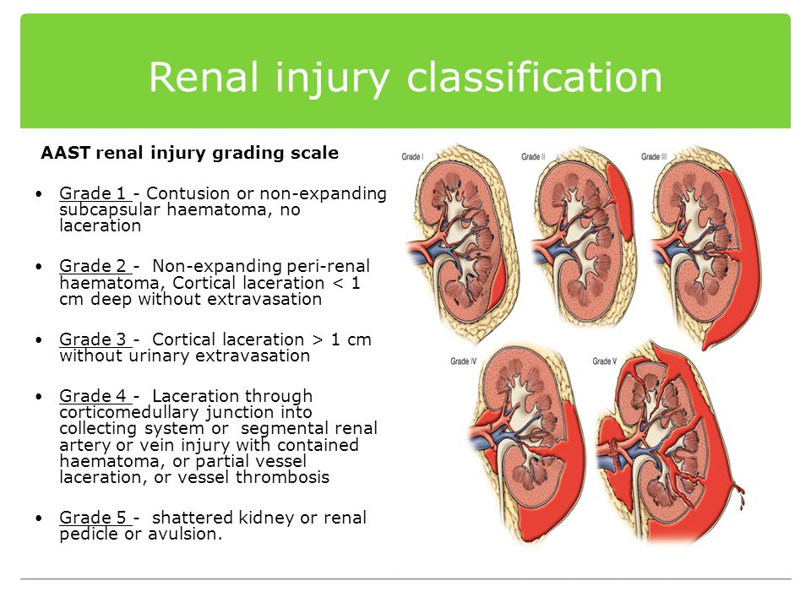
RENAL TRAUMA

Slide 15
SMALL BOWEL TRAUMA
Blunt or stab injury
It can be hematoma or lacerations.
Laceration may extend into the ampulla, distal CBD, pancreas or with duodenal devascularisation.
Presentation of hemoperitoneum or peritonitis.
Monks localising zones signify the small bowel of the small bowel injury.
Presence of pattern bruising over the abdominal wall signifies the small bowel injury and its site – London’s sign
Evisceration of small intestine

Slide 16
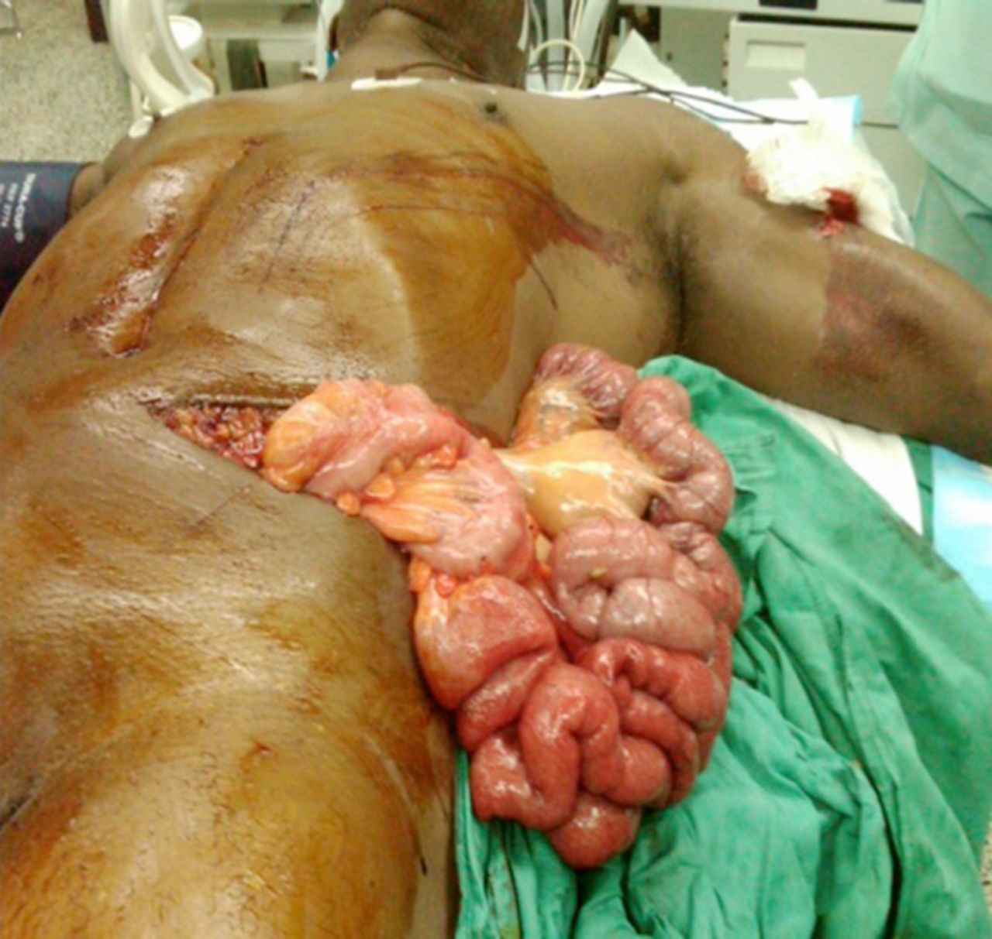
EVISCERATION OF ABDOMINAL CONTENTS AFTER STAB INJURY

Slide 17
CLINICAL FEATURES
Features of shock – pallor, tachycardia, hypotension, cold periphery, sweating, oliguria
Abdominal distension
Pain
Tenderness
Rebound tenderness
Guarding
Rigidity
Dullness in the flanks on percussion
.

Slide 18
Fracture of ribs, pelvis or vertebra
Respiratory distress, cyanosis depending on the amount of blood loss.
Bruising over the skin of the abdominal wall.
Hematuria
Melena
Referred pain
Evisceration of organs

